Slide 1

Kudu：Storage for Fast Analytics on Fast Data A
云尘

Slide 2
CONTENT
Why Kudu?
What’s Kudu?
Kudu Use cases
Kudu Architectures
Performance

Slide 3
Why Kudu?

Slide 4
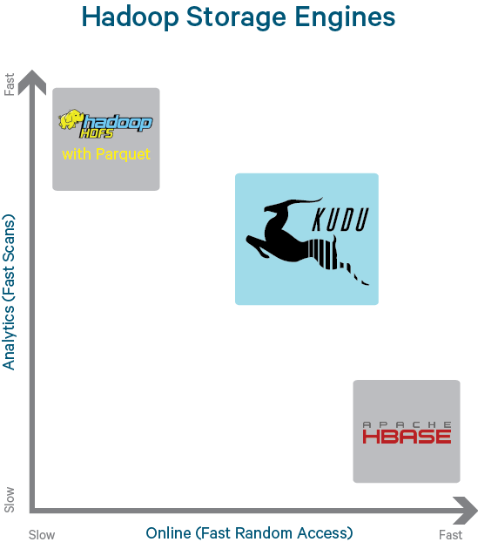
Current Storage Landscape in Hadoop Ecosystem
HDFS
批量写入
批量离线分析
Hbase
高速随机读写
CRUD操作
如果同时需要高吞吐率的顺序和随机读写的应用场景？

Slide 5
Changing Hardware landscape
Spinning disk -> solid state storage
NAND flash: Up to 450k read 250k write iops, about 2GB/sec read and 1.5GB/sec write throughput, at a price of less than $3/GB and dropping
3D XPoint memory (1000x faster than NAND, cheaper than RAM)
RAM is cheaper and more abundant:
64->128->256GB over last few years
Takeaway: The next bottleneck is CPU, and current storage systems weren’t designed with CPU efficiency in mind.

Slide 6
Kudu Design Goals
High throughput for big scans
Goal: Within 2x of Parquet
Low-latency for short accesses
Goal: 1ms read/write on SSD
Database-like semantics (initially single-row ACID)
Relational data model
SQL queries are easy
“NoSQL” style scan/insert/update (Java/C++ client)
Notes:
关系型数据库通常具有ACID特性：原子性（Atomicity）、一致性（Consistency）、隔离性（Isolation）、持久性（Durability）。

Slide 7
What’s Kudu？

Slide 8
What is it?
Kudu is an open source storage engine for structured data which supports low-latency random access together with efficient analytical access patterns
OLAP & OLTP ?
Notes:
Kudu定位于应对快速变化数据的快速分析型数据存储系统，弥补HDFS和HBase之间的的新型的存储，它能够更有效的利用现代硬件的CPU和IO资源，在随机读写和批量扫描之间找到一个平衡点，既能够支持分析，又能够支持更新、删除和实时查询

Slide 9
Scalable and fast tabular storage
Scalable
Tested up to 275 nodes (~3PB cluster)
Designed to scale to 1000s of nodes, tens of PBs
Fast
Millions of read/write operations per second across cluster
Multiple GB/second read throughput per node
Tabular
Store tables like a normal database (can support SQL, Spark, etc)
Individual record-level access to 100+ billion row tables (Java/C++/Python APIs)

Slide 10
Kudu Usage
Table has a SQL-like schema
Finite number of columns (unlike HBase/Cassandra)
Types: BOOL, INT8, INT16, INT32, INT64, FLOAT, DOUBLE, STRING, BINARY, TIMESTAMP
Fast ALTER TABLE
Java and C++ “NoSQL” style APIs
Insert(), Update(), Delete(), Scan()
Integrations with MapReduce, Spark, and Impala
Apache Drill work-in-progress

Slide 11
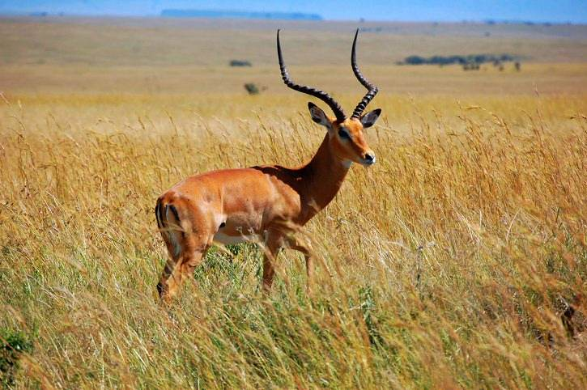
Kudu History
2012.10
cloudera发起
2014.9
小米加入
2015.10
对外公布
2015.11
Apache
2015.12
小米上生产环境
2016.X
1.X
2017.X
1.3.0
Notes:
关系型数据库通常具有ACID特性：原子性（Atomicity）、一致性（Consistency）、隔离性（Isolation）、持久性（Durability）。

Slide 12
Kudu Use Cases

Slide 13
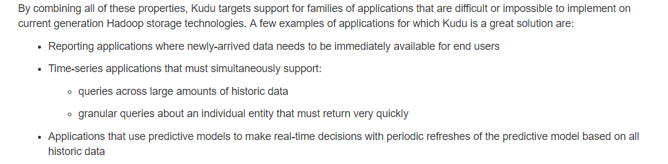
Kudu Use Cases
Kudu is best for use cases requiring a simultaneous combination of sequential and random reads and writes
Time Series
Examples: Stream market data; fraud detection & prevention; risk monitoring
Workload: Insert, updates, scans, lookups
Machine Data Analytics
Examples: Network threat detection
Workload: Inserts, scans, lookups
Online Reporting
Examples: ODS
Workload: Inserts, updates, scans, lookups

Slide 14
Real-Time Analytics in Hadoop Today Fraud Detection in the Real World = Storage Complexity
Incoming Data (Messaging System)
Impala on HDFS
Considerations:
How do I handle failure during this process?
How often do I reorganize data streaming in into a format appropriate for reporting?
When reporting, how do I see data that has not yet been reorganized?
How do I ensure that important jobs aren’t interrupted by maintenance?
Historic Data
Have we accumulated enough data?
Reporting Request
HBase
Reorganize HBase file into Parquet
Most Recent Partition
New Partition
Parquet File
Wait for running operations to complete
Define new Impala partition referencing the newly written Parquet file

Slide 15
Real-Time Analytics in Hadoop with Kudu
Incoming Data (Messaging System)
Storage in Kudu
Improvements:
One system to operate
No cron jobs or background processes
Handle late arrivals or data corrections with ease
New data available immediately for analytics or operations
Historical and Real-time
Data
Reporting Request

Slide 16
Kudu Architectures

Slide 17
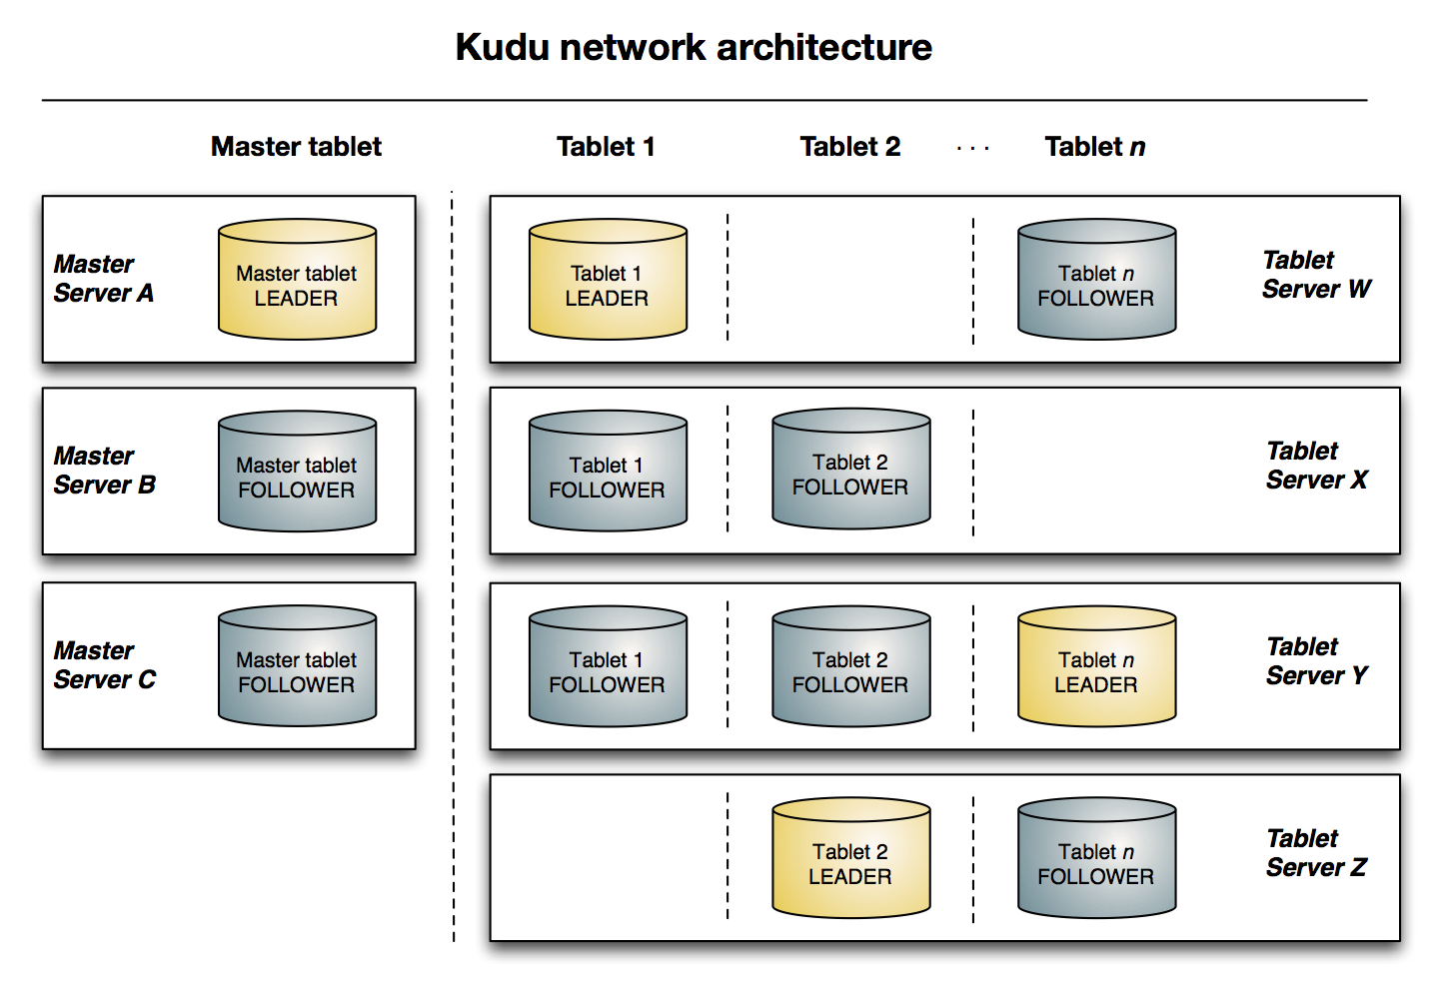

Slide 18
Table
A table is where your data is stored in Kudu.
A table has a schema and a totally ordered primary key.
A table is split into segments called tablets.
Tablet
A tablet is a contiguous segment of a table
A given tablet is replicated on multiple tablet servers(3 or 5)
one of these replicas is considered the leader tablet.
Tablet Server
A tablet server stores(local disk drives) and serves tablets to clients.
one tablet server acts as a leader
Only leaders service write requests,Leaders are elected using Raft Consensus Algorithm.
One tablet server can serve multiple tablets, and one tablet can be served by multiple tablet servers.

Slide 19
Master
The master keeps track of all the tablets, tablet servers, the Catalog Table, and other metadata related to the cluster.
At a given point in time, there can only be one acting master (the leader). If the current leader disappears, a new master is elected using Raft Consensus Algorithm.
The master writes the metadata for the new table into the catalog table, and coordinates the process of creating tablets on the tablet servers.
Tablet servers heartbeat to the master at a set interval (the default is once per second).
Catalog Table
The catalog table is the central location for metadata of Kudu.
It stores information about tables and tablets.
Tables
table schemas, locations, and states
Tablets
the list of existing tablets, which tablet servers have replicas of each tablet, the tablet’s current state, and start and end keys.

Slide 20
Meta Cache
Hey Master! Where is the row for ‘tlipcon’ in table “T”?
Client
T1: …
T2: …
T3: …
It’s part of tablet 2, which is on servers {Z,Y,X}. BTW, here’s info on other tablets you might care about: T1, T2, T3, …
UPDATE tlipcon SET col=foo

Slide 21
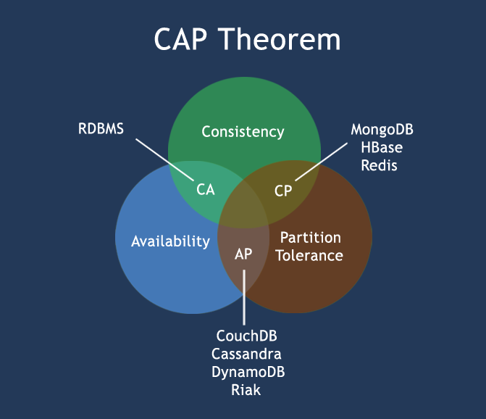
CAP
Notes:
一个分布式系统不可能同时满足一致性（C：Consistency）、可用性（A：Availability）和分区容错性（P：Partition tolerance）这三个基本需求，最多只能同时满足其中两项
1、一致性
在分布式环境下，一致性是指数据在多个副本之间能否保持一致的特性。在一致性的需求下，当一个系统在数据一致的状态下执行更新操作后，应该保证系统的数据仍然处于一直的状态。
2、可用性
可用性是指系统提供的服务必须一直处于可用的状态，对于用户的每一个操作请求总是能够在有限的时间内返回结果。这里的重点是"有限时间内"和"返回结果"。
3、分区容错性
分区容错性约束了一个分布式系统具有如下特性：分布式系统在遇到任何网络分区故障的时候，仍然需要能够保证对外提供满足一致性和可用性的服务，除非是整个网络环境都发生了故障。

Slide 22
Fault tolerance
Operations replicated using Raft consensus
Strict quorum algorithm. See Raft paper for details
Transient failures:
Follower: Leader can still achieve majority
Leader: automatic leader election (~5 seconds)
Restart dead TS within 5 min and it will rejoin transparently
Permanent failures
After 5 minutes, automatically creates a new follower replica and copies data
N replicas handle (N-1)/2 failures

Slide 23
Performance

Slide 24
TPC-H (Analytics benchmark)
75 server cluster
12 (spinning) disk each, enough RAM to fit dataset
TPC-H Scale Factor 100 (100GB)
Example query:
SELECT n_name, sum(l_extendedprice * (1 - l_discount)) as revenue FROM customer, orders, lineitem, supplier, nation, region WHERE c_custkey = o_custkey AND l_orderkey = o_orderkey AND l_suppkey = s_suppkey AND c_nationkey = s_nationkey AND s_nationkey = n_nationkey AND n_regionkey = r_regionkey AND r_name = 'ASIA' AND o_orderdate >= date '1994-01-01' AND o_orderdate < '1995-01-01’ GROUP BY n_name ORDER BY revenue desc;

Slide 25
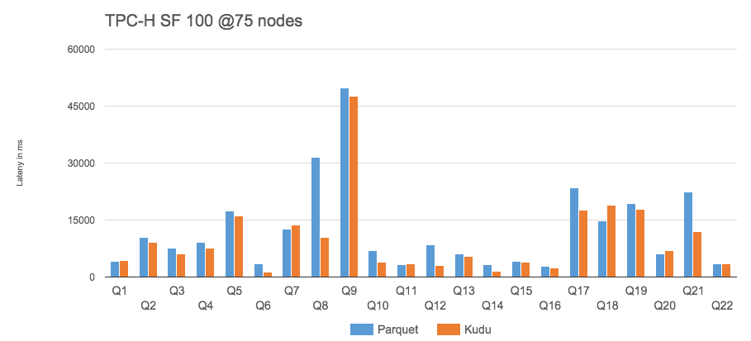
- Kudu outperforms Parquet by 31% (geometric mean) for RAM-resident data

Slide 26
Versus other NoSQL storage
Phoenix: SQL layer on HBase
10 node cluster (9 worker, 1 master)
TPC-H LINEITEM table only (6B rows)

Slide 27
Xiaomi benchmark
6 real queries from application trace analysis application
Q1: SELECT COUNT(*)
Q2: SELECT hour, COUNT(*) WHERE module = ‘foo’ GROUP BY HOUR
Q3: SELECT hour, COUNT(DISTINCT uid) WHERE module = ‘foo’ AND app=‘bar’ GROUP BY HOUR
Q4: analytics on RPC success rate over all data for one app
Q5: same as Q4, but filter by time range
Q6: SELECT * WHERE app = … AND uid = … ORDER BY ts LIMIT 30 OFFSET 30

Slide 28
Xiaomi: Benchmark Results
Query latency:
* HDFS parquet file replication = 3 , kudu table replication = 3
* Each query run 5 times then take average

Slide 29
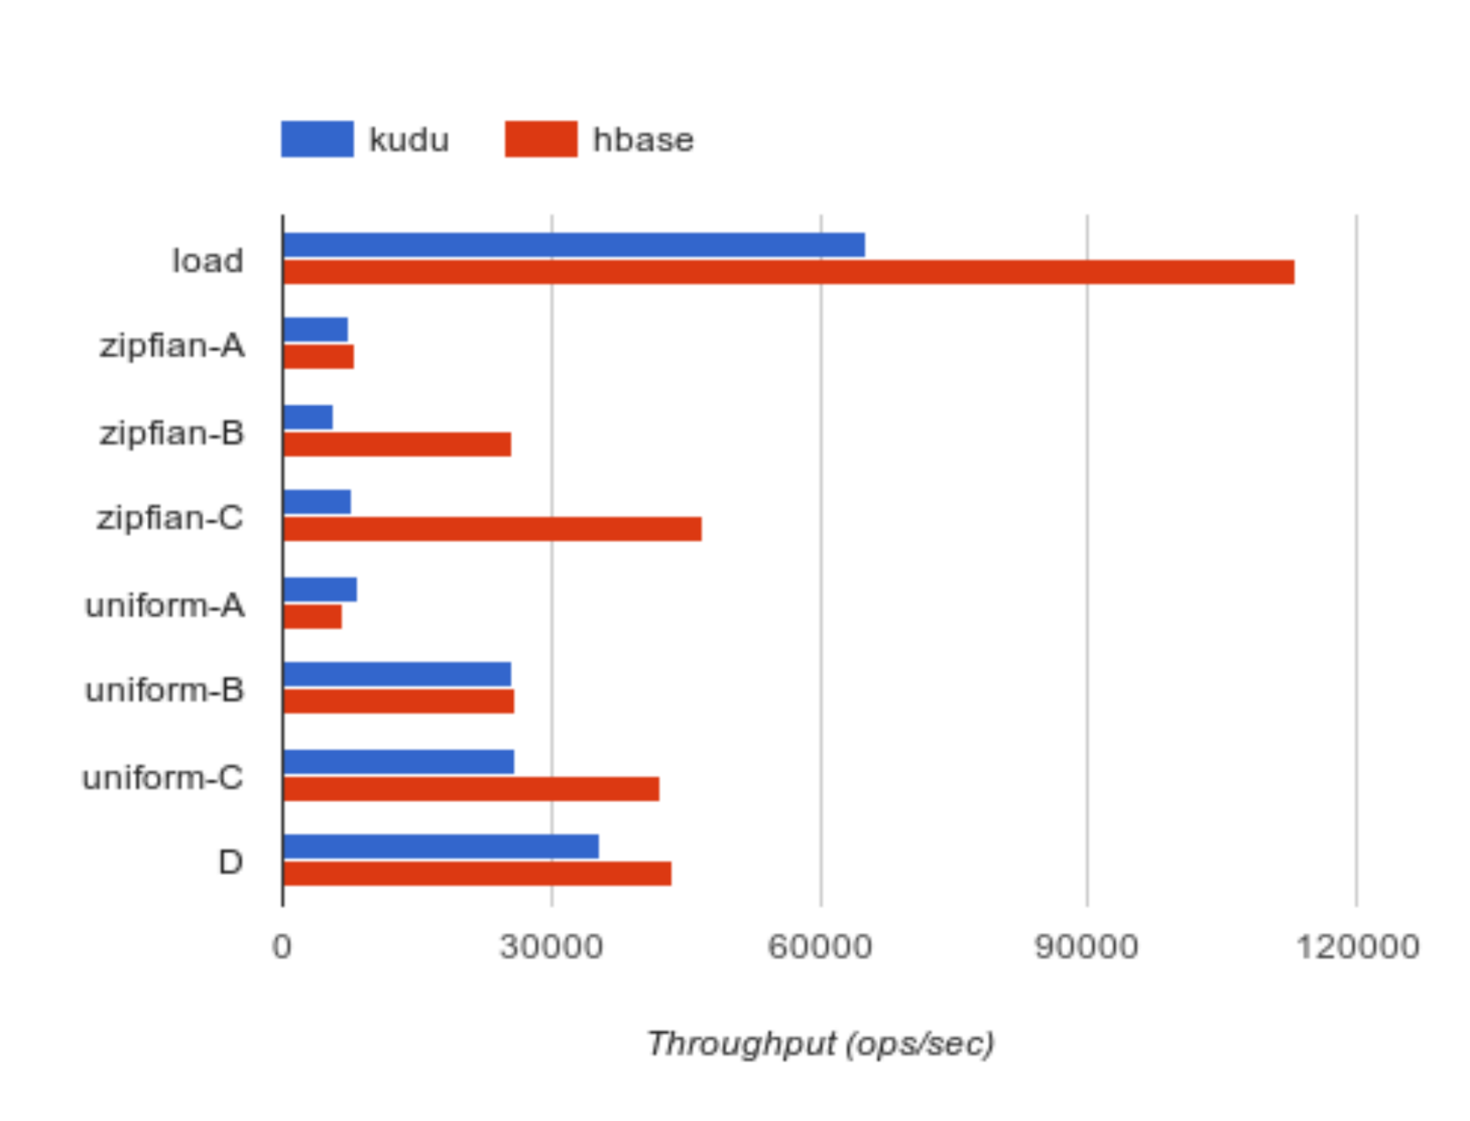
What about NoSQL-style random access? (YCSB)
YCSB 0.5.0-snapshot
10 node cluster (9 worker, 1 master)
100M row data set
10M operations each workload

Slide 30
Next Steps

Slide 31
KuDu Storage Model vs HBase Storage Model
KuDu Read/Write vs Hbase Read/Write
KuDu Schema Design
KuDu Integrations With Hadoop（spark/impala/Drill/MR）
Data Ingest To KuDu（flume/nifi/kafka .etc）
Select count(*) where xx=xxx
Select * from xxx where sfzid=xxxx

Slide 32
Thanks

Slide 33
Kudu：Storage for Fast Analytics on Fast Data B
云尘

Slide 34
CONTENT
Kudu Background
Kudu Columnar Storage
Kudu Inserts and Updates
Kudu Schema Design
Kudu Integrations
Kudu Performance Test

Slide 35
KuDu Background

Slide 36
Kudu is a columnar storage
On one hand immutable data on HDFS offers superior analytic performance, while mutable data in Apache HBase is best for operational workloads. Apache Kudu bridges this gap.
Kudu Architectures
Master/slave kudu-master / kudu-tserver
Table/Tablet/Tablet Server/Master/Raft Consensus Algorithm/Replication

Slide 37
KuDu Columnar Storage

Slide 38
Columnar Data Store
Kudu is a columnar data store.
A columnar data store stores data in strongly-typed columns.
Read Efficiency
For analytical queries, you can read a single column, or a portion of that column, while ignoring other columns.
This means you can fulfill your query while reading a minimal number of blocks on disk.
With a row-based store, you need to read the entire row, even if you only return values from a few columns.
Data Compression
Because a given column contains only one type of data, pattern-based compression can be orders of magnitude more efficient than compressing mixed data types, which are used in row-based solutions.
Combined with the efficiencies of reading data from columns, compression allows you to fulfill your query while reading even fewer blocks from disk

Slide 39
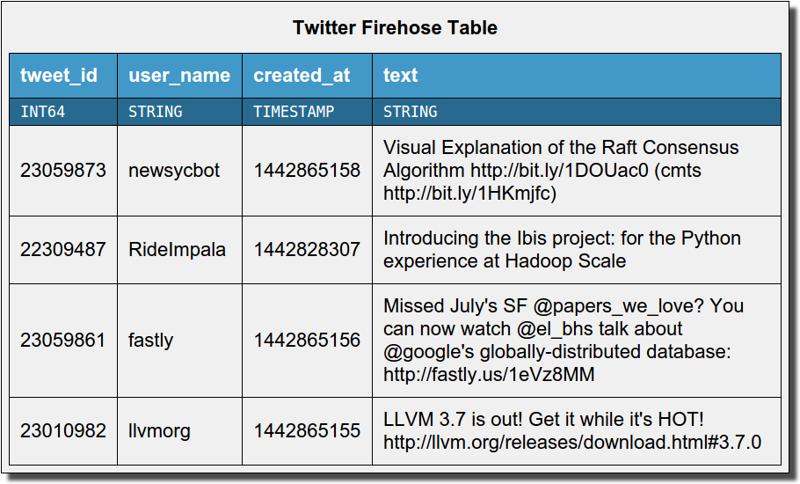
Columnar storage
Tweet_id
User_name
{25059873, 22309487, 23059861, 23010982}
{newsycbot, RideImpala, fastly, llvmorg}
Created_at
text
{1442865158, 1442828307, 1442865156, 1442865155}
{Visual exp…, Introducing .., Missing July…, LLVM 3.7….}

Slide 40
Columnar storage
Only read 1 column
Tweet_id
User_name
Created_at
text
{25059873, 22309487, 23059861, 23010982}
{newsycbot, RideImpala, fastly, llvmorg}
{1442865158, 1442828307, 1442865156, 1442865155}
{Visual exp…, Introducing .., Missing July…, LLVM 3.7….}
1GB
2GB
1GB
200GB
SELECT COUNT(*) FROM tweets WHERE user_name = ‘newsycbot’;

Slide 41
Columnar compression
Created_at | Diff(created_at)
1442865158 | n/a
1442828307 | -36851
1442865156 | 36849
1442865155 | -1
64 bits each | 17 bits each
Many columns can compress to a few bits per row!
Especially:
Timestamps
Time series values
Low-cardinality strings
Massive space savings and throughput increase!
Created_at
{1442865158, 1442828307, 1442865156, 1442865155}

Slide 42
KuDu Inserts and Updates

Slide 43
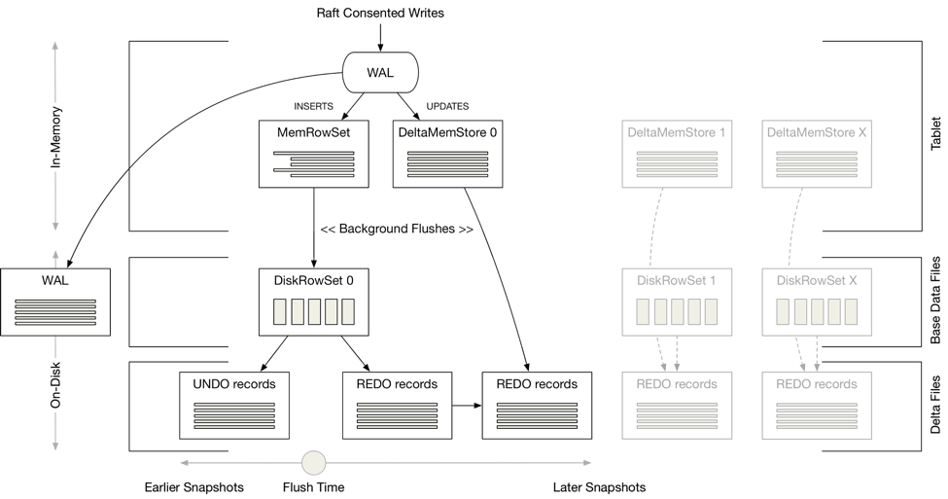

Slide 44
Handling inserts and updates
Inserts go to an in-memory row store (MemRowSet)
Durable due to write-ahead logging
Later flush to columnar format on disk
Updates go to in-memory “delta store”
Later flush to “delta files” on disk
Eventually “compact” into the previously-written columnar data files
Details elided here due to time constraints
available in other slide decks online, or read the Kudu whitepaper to learn more!

Slide 45
Kudu storage – Inserts and Flushes
MemRowSet
INSERT
(“todd”, “$1000”,”engineer”)
flush
DiskRowSet 1
name
pay
role

Slide 46
Kudu storage – Inserts and Flushes
MemRowSet
INSERT
(“doug”, “$1B”, “Hadoop man”)
flush
DiskRowSet 2
name
pay
role
DiskRowSet 1
name
pay
role

Slide 47
Kudu storage - Updates
MemRowSet
Each DiskRowSet has its own DeltaMemStore to accumulate updates
DiskRowSet 2
Delta MS
name
pay
role
base data
DiskRowSet 1
Delta MS
name
pay
role
base data

Slide 48
Kudu storage - Updates
MemRowSet
UPDATE set pay=“$1M” WHERE name=“todd”
Is the row in DiskRowSet 2?
(check bloom filters)
DiskRowSet 2
Bloom says: no!
Delta MS
name
pay
role
base data
Is the row in DiskRowSet 1?
(check bloom filters)
DiskRowSet 1
Bloom says: maybe!
Delta MS
name
pay
role
150: pay=$1M @ time T
Search key column to find offset: rowid = 150

Slide 49
Kudu storage – Read path
MemRowSet
DiskRowSet 2
Delta MS
Read rows in DiskRowSet 2
name
pay
role
base data
Updates are applied based on ordinal offset within DRS: array indexing = fast
DiskRowSet 1
Delta MS
Then, read rows in DiskRowSet 1
name
pay
role
150: pay=$1M @ time T
base data

Slide 50
Kudu storage – Delta flushes
MemRowSet
A REDO delta indicates how to transform between the ‘base data’ (columnar) and a later version
DiskRowSet 2
Delta MS
name
pay
role
base data
DiskRowSet 1
Delta MS
REDO DeltaFile
Flush
name
pay
role
150: pay=$1M @ time T
base data

Slide 51
Kudu storage – Major delta compaction
Many deltas accumulate: lots of delta application work on reads
DiskRowSet(pre-compaction)
Delta MS
REDO DeltaFile
REDO DeltaFile
REDO DeltaFile
name
pay
role
Merge updates for columns with high update percentage
DiskRowSet(post-compaction)
Delta MS
UNDO deltas
Unmerged REDO deltas
name
pay
role
base data
If a column has few updates, doesn’t need to be re-written: those deltas maintained in new DeltaFile

Slide 52
Kudu storage – RowSet Compactions
DRS 1 (32MB)
[PK=alice], [PK=joe], [PK=linda], [PK=zach]
DRS 2 (32MB)
[PK=bob], [PK=jon], [PK=mary] [PK=zeke]
DRS 3 (32MB)
[PK=carl], [PK=julie], [PK=omar] [PK=zoe]
Reorganize rows to avoid rowsets with overlapping key ranges
DRS 4 (32MB)
DRS 5 (32MB)
DRS 6 (32MB)
[alice, bob, carl, joe]
[jon, julie, linda, mary]
[omar, zach, zeke, zoe]

Slide 53
KuDu Schema Design

Slide 54
Why Column Design？
The perfect schema would accomplish the following:
Data would be distributed in such a way that reads and writes are spread evenly across tablet servers. This is impacted by partitioning.
Tablets would grow at an even, predictable rate and load across tablets would remain steady over time. This is most impacted by partitioning.
Scans would read the minimum amount of data necessary to fulfill a query. This is impacted mostly by primary key design, but partitioning also plays a role via partition pruning.

Slide 55
Column Design
strongly-typed
boolean
8-bit signed integer
16-bit signed integer
32-bit signed integer
64-bit signed integer
unixtime_micros (64-bit microseconds since the Unix epoch)
single-precision (32-bit) IEEE-754 floating-point number
double-precision (64-bit) IEEE-754 floating-point number
UTF-8 encoded string (up to 64KB)
binary (up to 64KB)

Slide 56
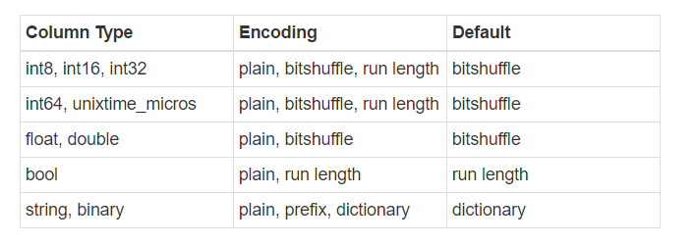
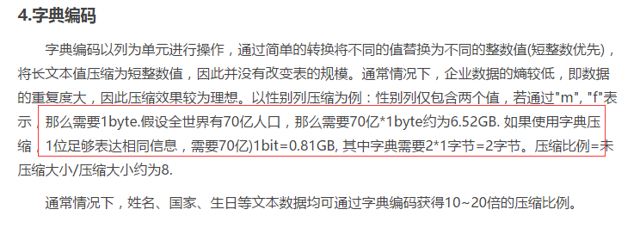
Column Encoding

Slide 57
Column Compression
LZ4
Snappy
Zlib
Gzip？
Lzo？
Bzip？

Slide 58
Primary Key Design
Every Kudu table must declare a primary key index comprised of one or more columns.
Once set during table creation, the set of columns in the primary key may not be altered.
Like an RDBMS primary key, the Kudu primary key enforces a uniqueness constraint
Unlike an RDBMS, Kudu does not provide an auto-incrementing column feature, so the application must always provide the full primary key during insert.
As with many traditional relational databases, Kudu’s primary key is a clustered index. All rows within a tablet are kept in primary key sorted order.

Slide 59
Partitioning
Range Partitioning
Hash Partitioning
Multilevel Partitioning
Zero or more hash partition levels can be combined with an optional range partition level

Slide 60
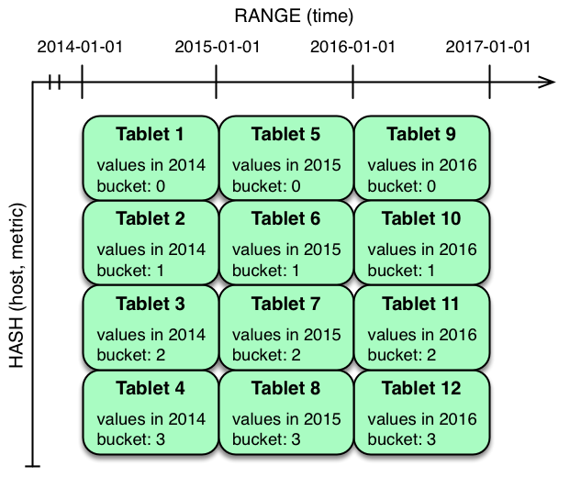
Partitioning
譬如有一行数据是 (host, metric, time, value)，time 是单调递增的
如果我们将 time 按照 hash 的方式分区，虽然能保证数据分散到不同的 Tablets 上面，但如果我们想查询某一段时间区间的数据，就得需要全部扫描所有的 Tablets 了。
所以通常对于 time，我们都是采用 range 的分区方式。但 range 的方式会有 hot range 的问题，也就是同一个时间会有大量的数据写到一个 range 上面，而这个 hot range 是没法通过 scale out 来缓解的
所以我们可以将 (host, metric) 按照 hash 分区，这样就在 write 和 read 之间提供了一个平衡。

Slide 61
Known Limitations
Number of Columns
By default, Kudu will not permit the creation of tables with more than 300 columns. We recommend schema designs that use fewer columns for best performance.
Size of Cells
No individual cell may be larger than 64KB. The cells making up a composite key are limited to a total of 16KB after the internal composite-key encoding done by Kudu. Inserting rows not conforming to these limitations will result in errors being returned to the client.
Size of Rows
Although individual cells may be up to 64KB, and Kudu supports up to 300 columns, it is recommended that no single row be larger than a few hundred KB.
Valid Identifiers
Identifiers such as table and column names must be valid UTF-8 sequences and no longer than 256 bytes.
Immutable Primary Keys
Kudu does not allow you to update the primary key columns of a row.
Non-alterable Primary Key
Kudu does not allow you to alter the primary key columns after table creation.
Non-alterable Partitioning
Kudu does not allow you to change how a table is partitioned after creation, with the exception of adding or dropping range partitions.
Non-alterable Column Types
Kudu does not allow the type of a column to be altered.
Partition Splitting
Partitions cannot be split or merged after table creation.

Slide 62
KuDu Integrations

Slide 63
Spark DataSource integration
kuduContext.createTable(
"test_table", df.schema, Seq("id"),
new CreateTableOptions()
.setNumReplicas(1)
.addHashPartitions(List("id").asJava, 3))
// Insert data
kuduContext.insertRows(df, "test_table")
// Delete data
kuduContext.deleteRows(filteredDF, "test_table")
// Upsert data
kuduContext.upsertRows(df, "test_table")
// 4，Data can also be inserted into the Kudu table using the data source, though the methods on KuduContext are preferred
df.write.options(Map("kudu.master"-> "192.168.1.12:7051", "kudu.table"-> "test_table")).mode("append").kudu
// Check for the existence of a Kudu table
kuduContext.tableExists("another_table")
// Delete a Kudu table
kuduContext.deleteTable("unwanted_table")
spark-shell --packages org.apache.kudu:kudu-spark_2.10:1.3.0
import org.apache.kudu.spark.kudu._
import org.apache.kudu.client._
import collection.JavaConverters._
//1， Read a table from Kudu
val df = sqlContext.read.options(Map("kudu.master" -> "192.168.1.12:7051","kudu.table" -> "impala::default.my_first_table")).kudu
df.select("id","name").collect
//2， ...or register a temporary table and use SQL
df.registerTempTable("kudu_table")
val filteredDF = sqlContext.sql("select id from kudu_table where id >= 5")
//3， Use KuduContext to create, delete, or write to Kudu tables
val kuduContext = new KuduContext("192.168.1.12:7051")

Slide 64
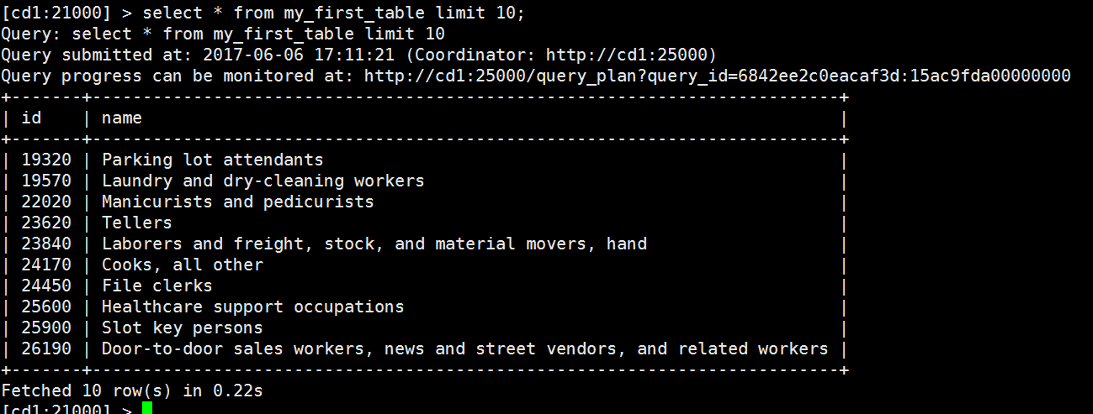
Impala integration
CREATE TABLE … PARTITION BY HASH(col1) PARTITIONS 16 STORED AS KUDU
INSERT/UPDATE/DELETE
CREATE TABLE my_first_table
(
id BIGINT,
name STRING,
PRIMARY KEY(id)
)
PARTITION BY HASH PARTITIONS 16
STORED AS KUDU;
insert into my_first_table select salary,description from sample_07;

Slide 65
Data Ingest To KuDu

Slide 66
Nifi （ in development）+kudu
NiFi 3973 - Create a new Kudu Processor to ingest data
Spark+kafka+kudu
https://dzone.com/articles/how-to-build-a-prediction-engine-using-spark-kudu

Slide 67
Performance Test

Slide 68
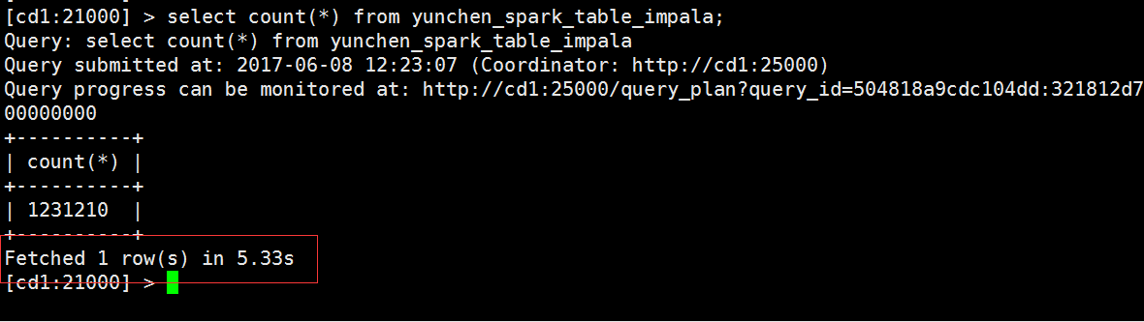
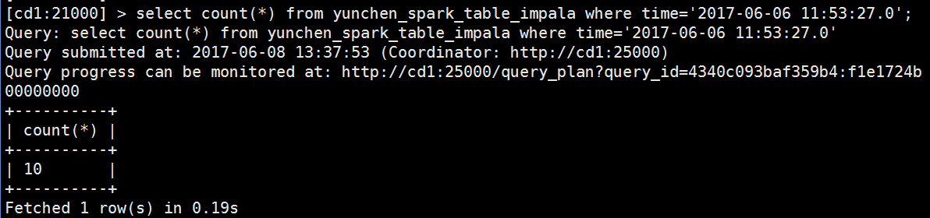
Select count(*) where xx=xxx

Slide 69
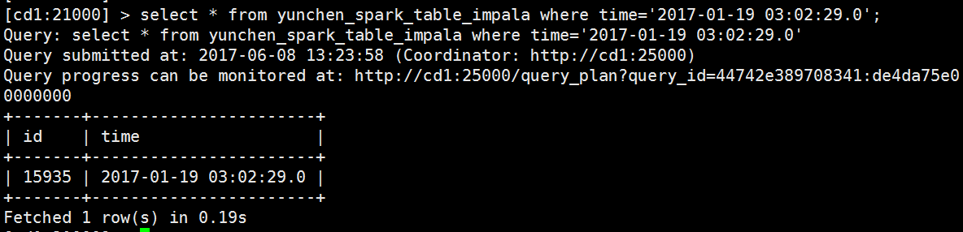
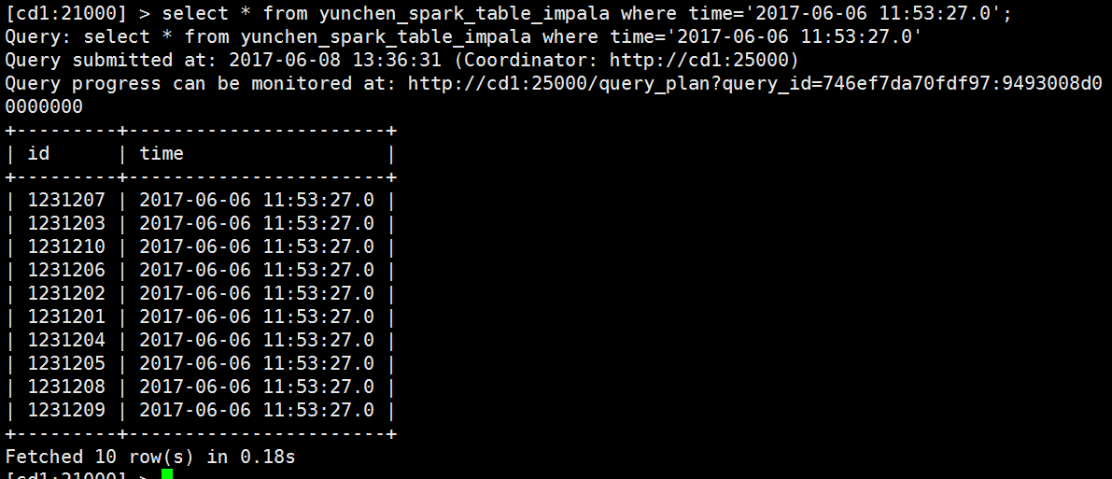
Select * from xxx where sfzid=xxxx

Slide 70
Reference Linking
http://kudu.apache.org/docs/
http://blog.cloudera.com/blog/2017/04/apache-kudu-read-write-paths/
http://kudu.apache.org/kudu.pdf
http://kudu.apache.org/faq.html
https://blog.cloudera.com/blog/2017/02/up-and-running-with-apache-spark-on-apache-kudu/
Kudu: Fast Analytics on Fast Data pptx

Slide 71
Thanks

